Slide 1



Data Science Team 5 Project
Customer Premium Prediction: Analyzing and Predicting Insurance Premiums

Slide 2


Contents
Presentation
1. Introducing Datasets
1
4. Regression Analysis
4
- 500 Customer Information - 14 characteristic variables - Target variable: premium
- Linear regression model by cluster - Model Performance Evaluation - Breakdown Analysis
2. data preprocessing
2
5. Model Implementation
5
- Missing value processing - Encoding categorical variables - Characteristics Grouping and Normalizing
- Normalization of Variables - Learning linear regression models - Processing User Inputs
3. Cluster Analysis
3
6. Conclusions and Future Improvement Measures
6
- K-means clustering - Individual, Health, Other Score-Based - Cluster Characterization
- Project Summary - Breakdown Analysis - Future Improvement Measures

Slide 3





Presentation
Insurance Customer Information Dataset
Introducing Datasets
The dataset contains 14 characteristics for each customer. It consists of numerical data such as age, income, and health scores, as well as categorical data such as gender, marital status, and smoking status.
In this project, a premium forecasting model is developed using a dataset containing information on 500 subscribers. This dataset covers realistic topics applicable to real financial product design.
Dataset configuration and features
- Target variable: premium - Numerical variables: Age, income, health score, etc - Categorical variables: Gender, marital status, smoking status, etc - Includes 500 total customer data

Slide 4



Presentation
Reason for Dataset Selection
The main reason for choosing this dataset is that it deals with realistic topics that can be directly applied to real-world financial product design. Insurance premium forecasting is an important challenge in the financial industry, and this project gives you close-to-practical experience.
1
a wide range of analytical opportunities
2
Delivering a Practical Experience
-Correlation analysis, clustering, regression modeling, etc - Various variable types (numerical, categorical) - Can analyze complex relationships - Opportunities to apply multiple analytical techniques
- Missing value processing experience - Data preprocessing practice - Apply classification, regression, clustering, etc - Learn the actual data analysis process

Slide 5


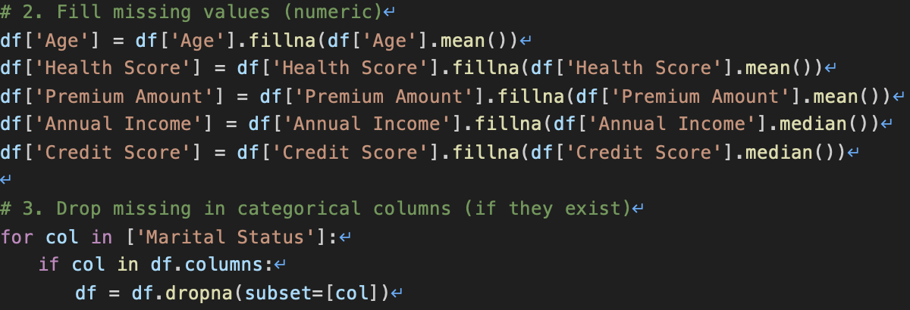

Presentation
Data preprocessing (1)
1
Missing Value Handling: Numerical Variables
Dealing with Missing Values: Categorical Variables
Pre-processing Results
- Age, Health Score, Insurance Premiums: Average Value - Normal distribution assumption - Annual Income, Credit Score: Median - Asymmetric distribution and outliers are considered
- Marital status: delete missing row - Considering that it is not a major characteristic - Other categorical variables: Separate processing - Maintain data integrity
- Improve data quality - Increase analytical reliability - Expect Model Performance Improvements - Improved ability to cope with real-world situations

Slide 6
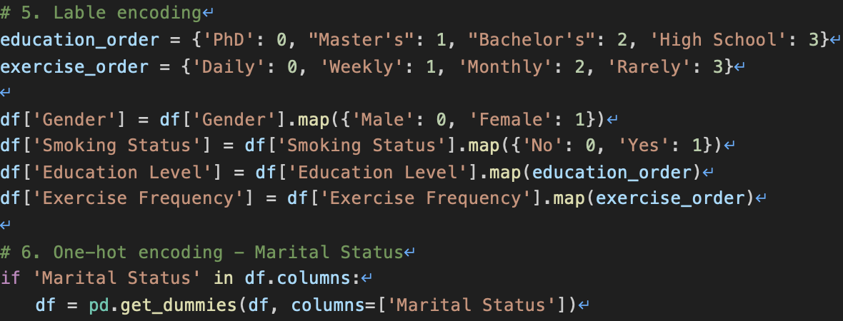
Presentation
Data Preprocessing (2)
2
Categorical Variable Encoding
Binary Variables
Ordered Variables
Marital Status
- Process of converting
- categorical data into
- numerical format for
- model input
- Gender, smoking status
- Mapped to 0 and 1
- Using label encoding
- Single column result
- Education level
- Exercise frequency
- Mapped from 0 to 3
- Based on inherent order
- No inherent order
- Used one-hot encoding
- Converted to separate
- columns to avoid bias

Slide 7
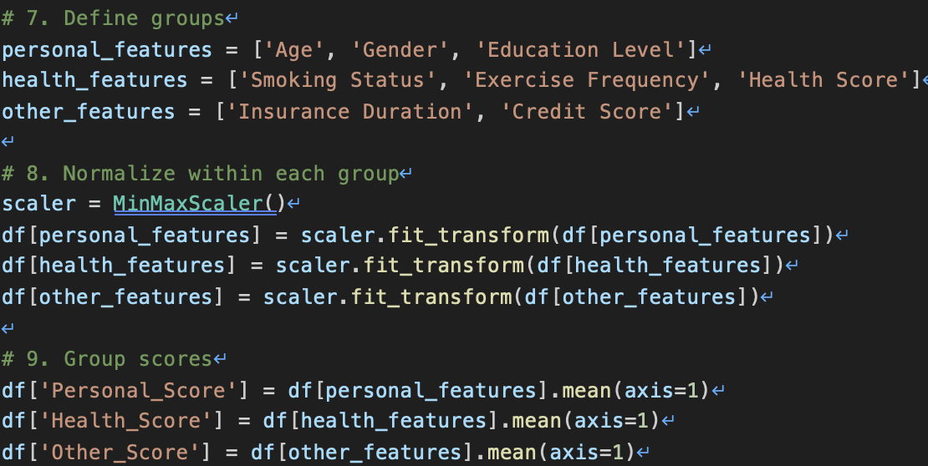
Presentation
Data Preprocessing (3)
Feature Grouping
Group-Specific Scores
- Variables divided into
- three main groups:
- personal, health, and
- other characteristics
- Calculated average of
- normalized variables
- within each group
- Created group scores
Personal Information Group
Health-Related Group
- Includes age, gender,
- and education level
- Normalized and averaged
- Reflects individual characteristics
Normalization
- Comprises smoking status,
- exercise frequency, health score
- Normalized and averaged
- Indicates overall health condition
- MinMaxScaler applied
- Scaled variables from
- 0 to 1 for each group
- Eliminated scale differences

Slide 8
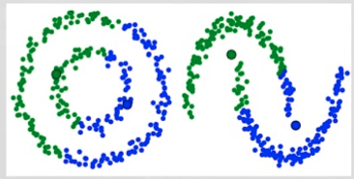
Presentation
Clustering Analysis Overview
K-Means Clustering on Group Scores
We employed K-Means clustering algorithm on the group scores derived from personal, health, and other characteristics. Three clusters were created for each group to capture diverse customer profiles.
This section outlines the clustering analysis process applied to our preprocessed dataset, focusing on identifying distinct customer segments.
Visualization and Interpretation
Boxplots were used to visualize the distribution of scores within each cluster, enabling us to interpret and characterize the distinct customer segments effectively.

Slide 9
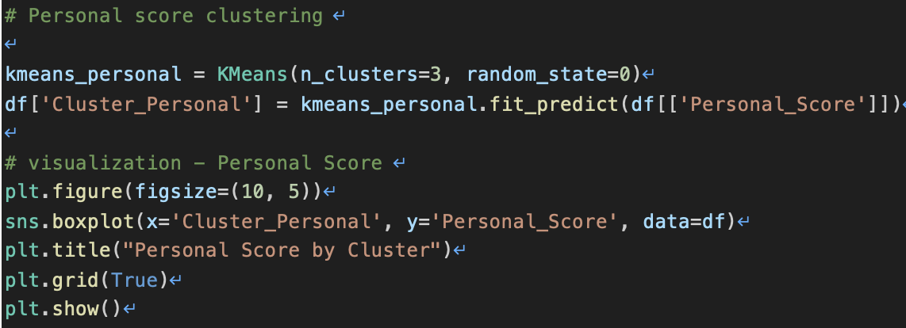
Presentation
Personal Score Clustering
We applied K-Means clustering to personal scores derived from age, gender, and education level. This process aimed to identify distinct customer segments based on individual characteristics.
1
Cluster Characteristics
2
Visualization Results
- Cluster 0: Highest average
- Educated elderly females
- Cluster 1: Lowest mean
- Wide distribution range
- Boxplot showed 3 clusters
- Clear score differences
- Cluster 2: Medium scores
- Most evenly distributed

Slide 10
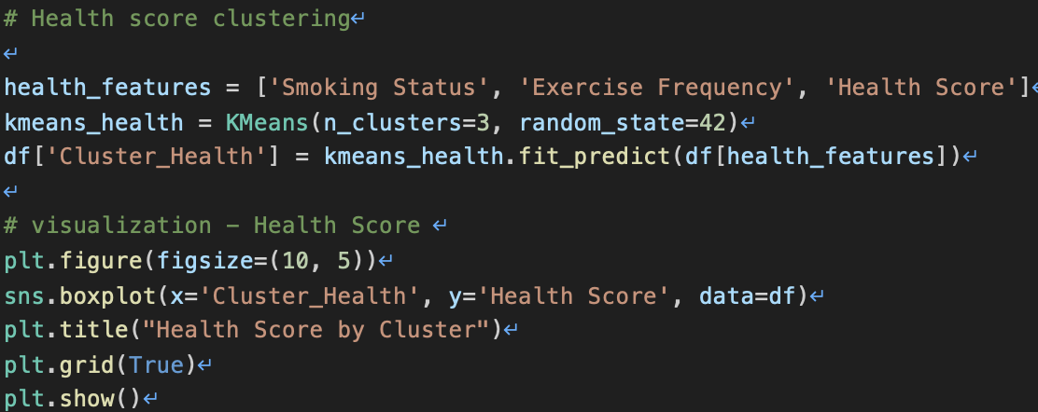
Presentation
Health Score Clustering
Cluster 0: High-Risk Group
Cluster 1: Mixed Health Group
Cluster 2: Healthy Group
- Median score around 0.3
- Lower quartile near 0
- Likely smokers
- Under-exercisers
- Many outliers present
- Non-smokers included
- Varied exercise patterns
- Diverse health scores
- Highest median score
- Balanced health scores
- Frequent exercisers
- Low percentage smokers

Slide 11
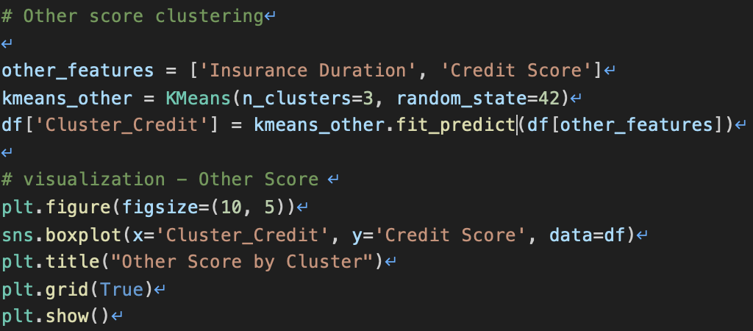
Presentation
Other Score Clustering
Clustering Basis
Number of Clusters
Visualization Method
Cluster Characteristics
- Insurance period
- Credit score
- Grouped customer data
based on these factors
- Three clusters created
- K-Means algorithm used
- Optimal grouping of
customer data
- Boxplot used
- Visualizes distribution
of credit scores
- Shows cluster differences
- Cluster 0: Good credit
- Cluster 1: Moderate risk
- Cluster 2: High risk
- Pricing implications

Slide 12
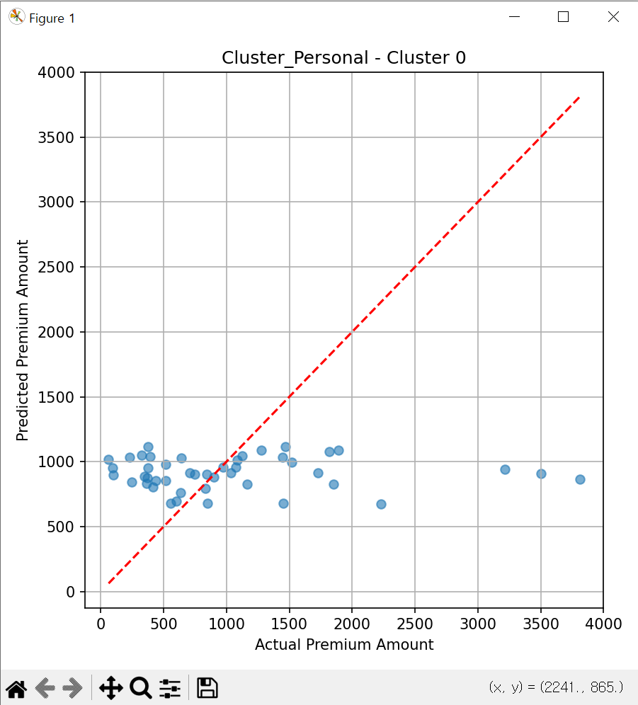
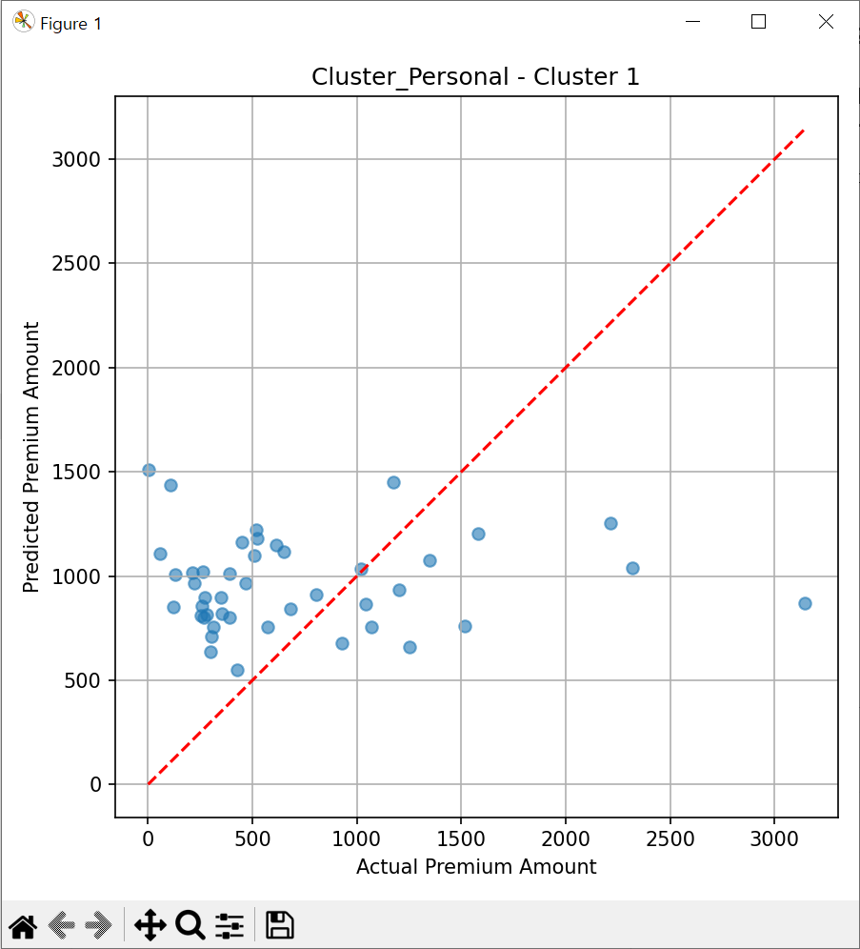
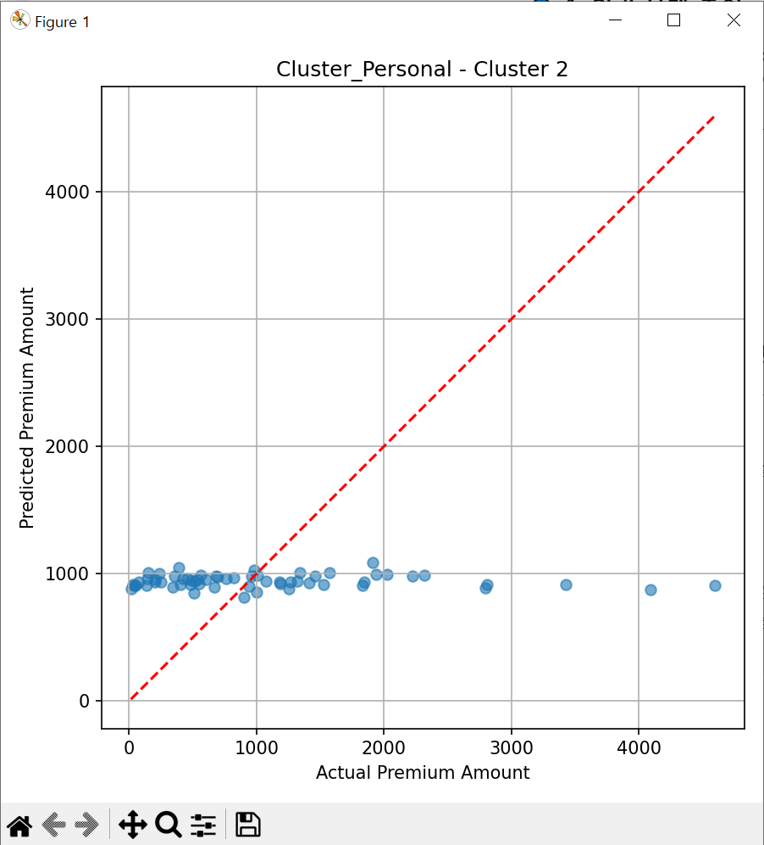
Presentation
Personal Score Cluster Analysis
Cluster Comparison
- Cluster 0: High-value, educated elderly
females
- Cluster 1: Diverse, includes low-value
customers
- Cluster 2: Average, balanced group
Cluster 0 Overview
Cluster 1 Overview
Cluster 2 Overview
Implications
- Highest average score
- Predominantly elderly
- Highly educated
- Mostly females
- Lowest mean score
- Wide distribution
- Includes extremely low
values
- Medium score range
- Most evenly distributed
- Balanced demographics
- Tailored marketing strategies for each
cluster
- Personalized product offerings based on
cluster characteristics
- Risk assessment and pricing considerations

Slide 13



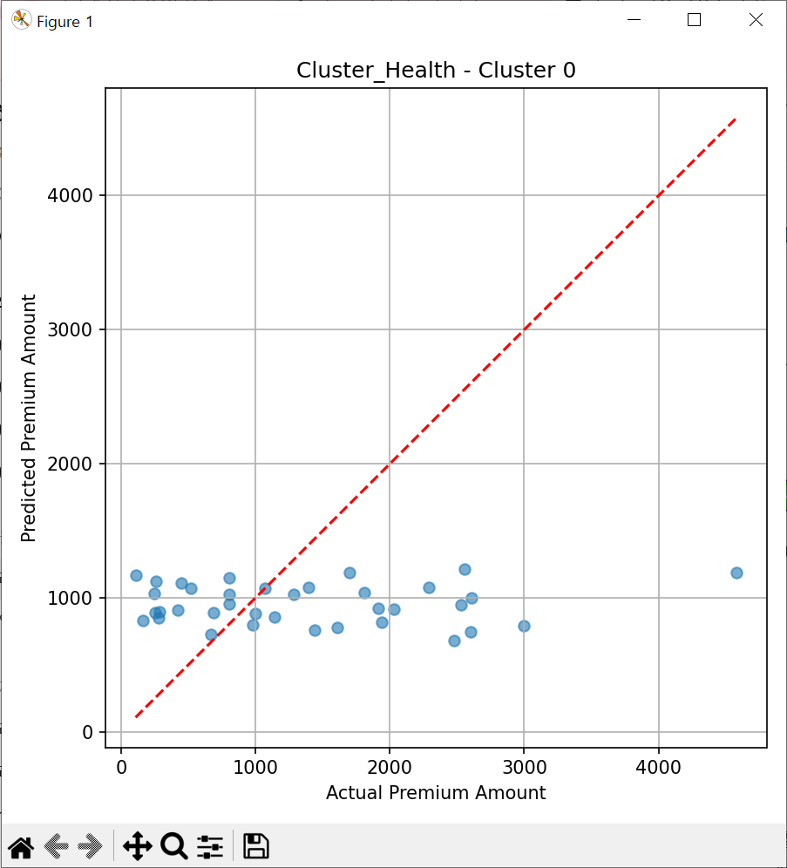
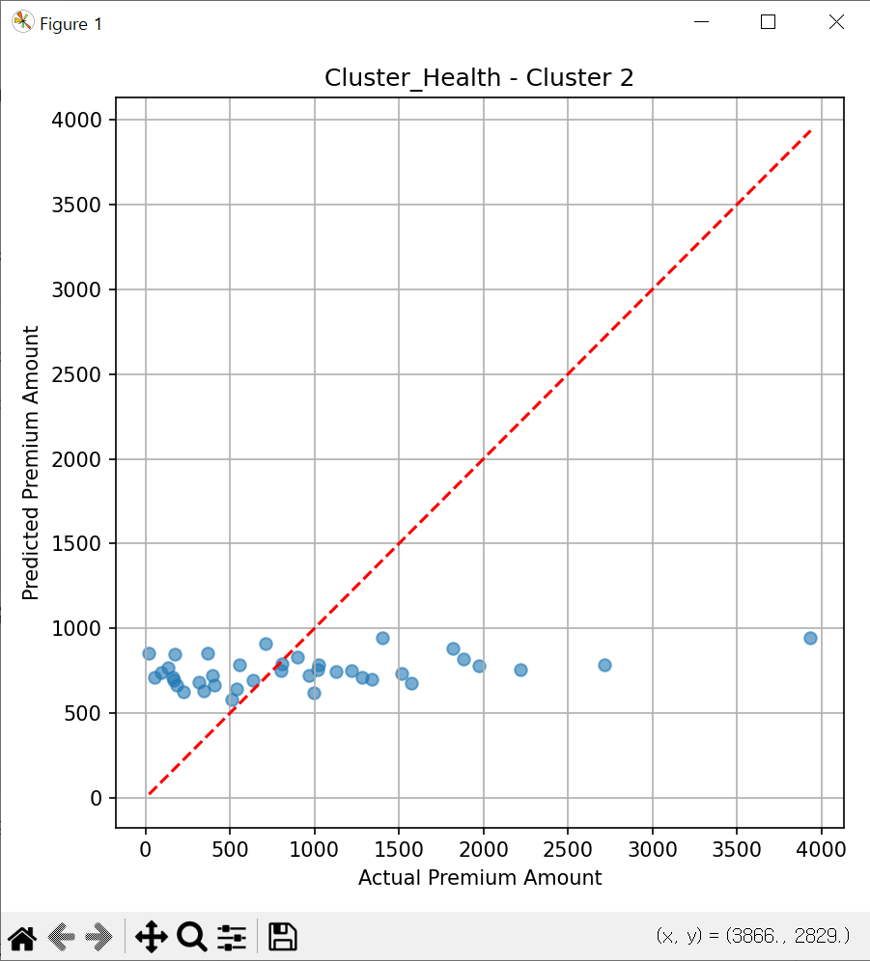

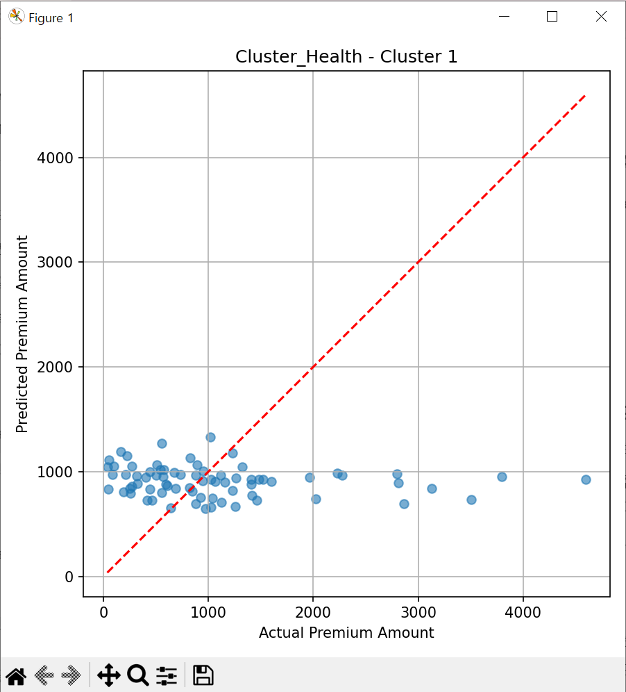
Presentation
Health Score Cluster Analysis
1
3
2
Cluster 0
Cluster 2
- Low health scores
- Median around 0.3
- Lower quartile near 0
- Likely smokers or under-exercisers
- High-risk group
- Highest median health score
- Balanced health score distribution
- Frequent exercisers or non-smokers
- Healthiest group overall
- Low-risk group
Cluster 1
- Non-smokers predominantly
- Varied exercise patterns
- Many outliers in health scores
- Mixed health profiles
- Moderate risk group

Slide 14



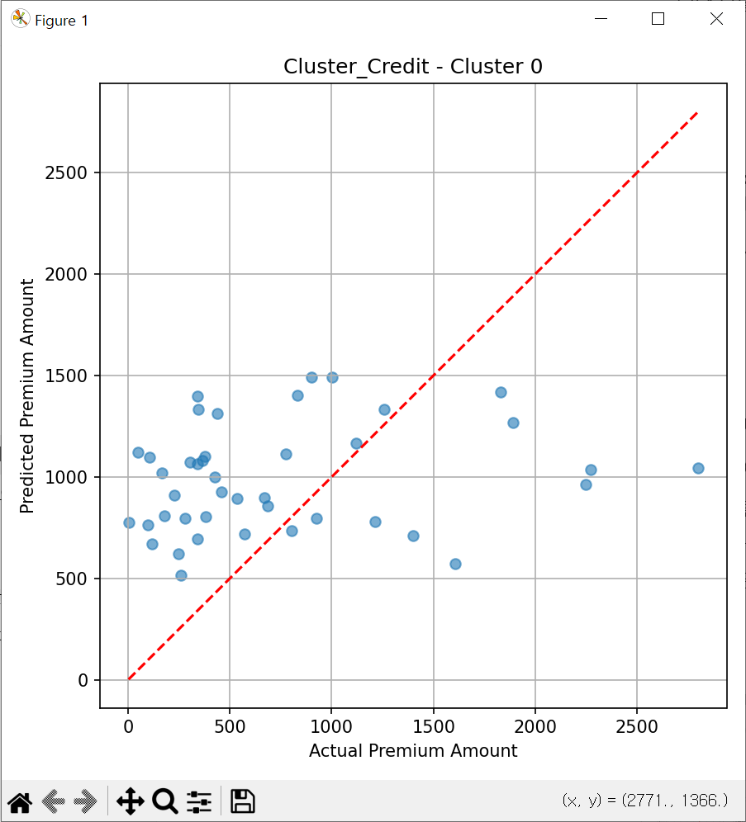
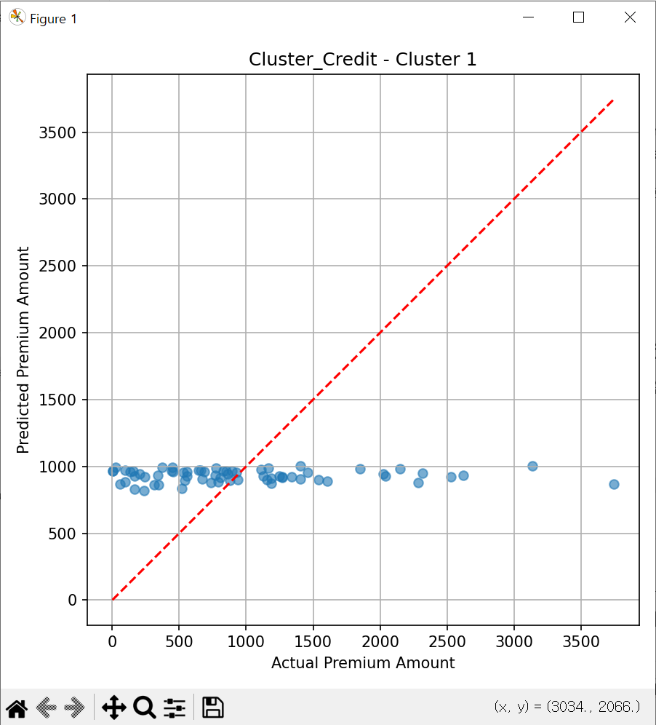
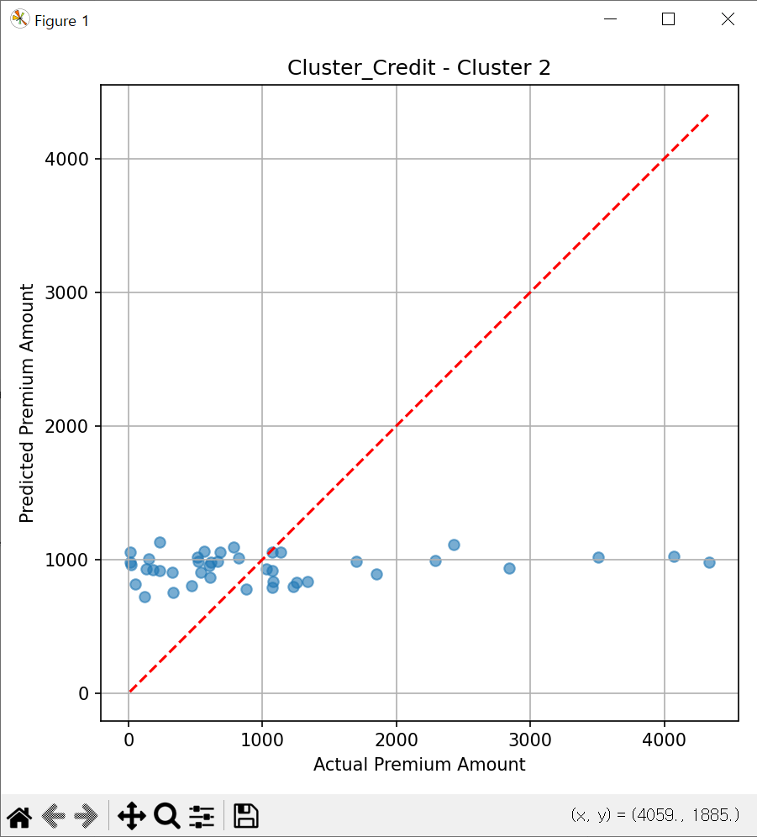


Presentation
Other Score Cluster Analysis
1
2
3
4
Cluster 0
Cluster 1
Cluster 2
Implications
- Good credit customers
- Scores mostly 0.3+
- Longer insurance coverage
- Wide score distribution
- Low-risk group
- Moderate credit scores
- Mix of risk levels
- Some low outliers
- Varied insurance history
- Medium-risk group
- High credit risk customers
- Very low median score
- Narrow score distribution
- Likely shorter coverage
- High-risk group
- Pricing strategy per cluster
- Tailored coverage options
- Risk management policies
- Customer retention focus
- Targeted marketing plans

Slide 15

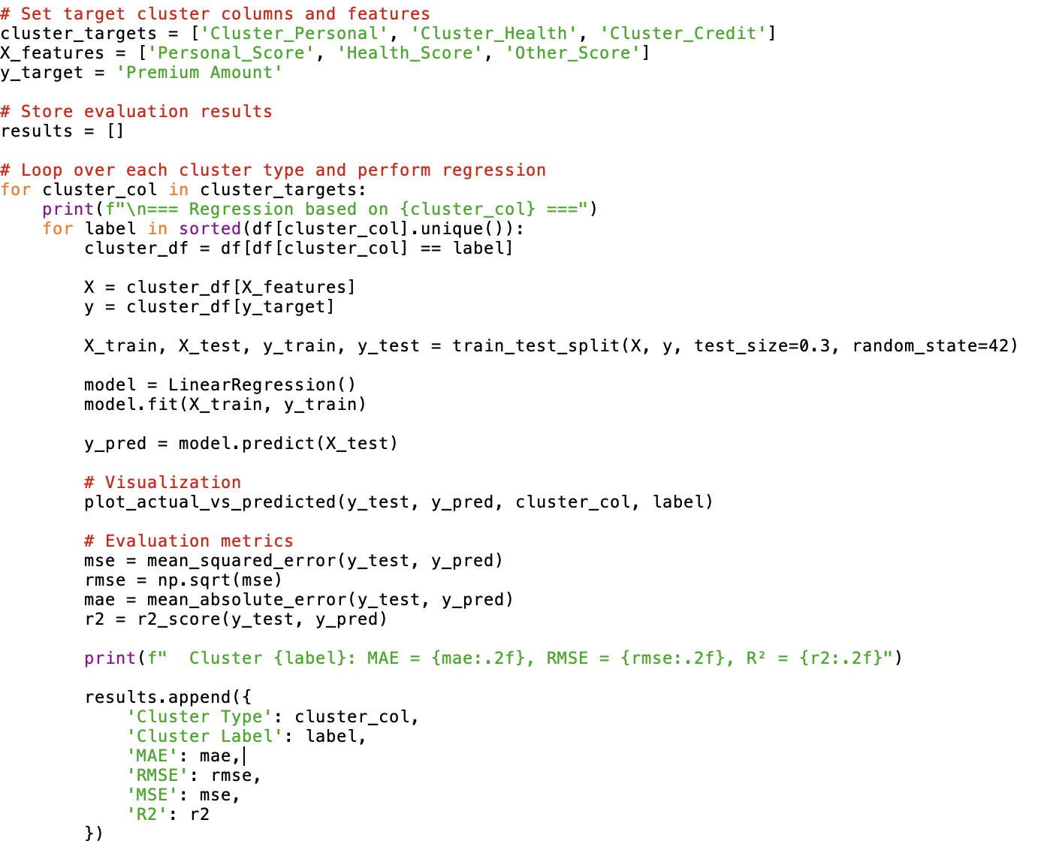

Regression Analysis Process
Presentation
Goal
Input Variables
Model Approach
Evaluation
Visualization
- Predict Premium Amount
- Utilize customer data
- Cluster-based modeling
- Accurate pricing
- Personal scores
- Health scores
- Other scores (credit)
- Cluster assignments
- Separate models per cluster
- Linear regression
- 70:30 train-test split
- Cluster-specific patterns
- Mean Absolute Error (MAE)
- Root Mean Square Error
- R-squared (R²)
- Model performance check
- Scatter plots
- Actual vs predicted
- Cluster-wise comparison
- Performance analysis

Slide 16
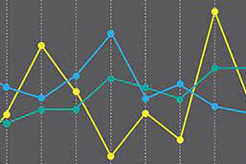
Presentation
Personal Score Clusters Analysis
Regression Results
The regression analysis for personal score clusters revealed significant limitations in predicting insurance premiums. All clusters demonstrated extremely low predictive power, indicating a weak relationship between personal scores and premium amounts.
This section presents the regression analysis results for personal score clusters, focusing on the model's predictive power and limitations.
Performance Metrics and Implications
- R² values close to zero across all clusters
- Low overall predictive power of the model
- Limited ability to capture premium variations
- Suggests personal scores alone insufficient

Slide 17

Presentation
Health Score Clusters Results
The regression analysis for health score clusters showed varying results across different groups. This section focuses on the performance of each cluster and its implications for premium prediction.
1
Cluster 2 Performance
2
Overall Health Score Analysis
- Highest performance among all clusters
- R² value of 0.02, indicating some explanatory power
- Suggests potential correlation between health scores and premiums
- May represent a more predictable customer segment
- Generally low R² values across clusters
- Limited predictive power for most health score groups
- Indicates complexity in health-premium relationship
- Suggests need for more sophisticated modeling approaches

Slide 18
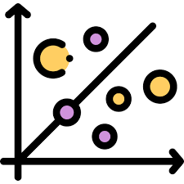

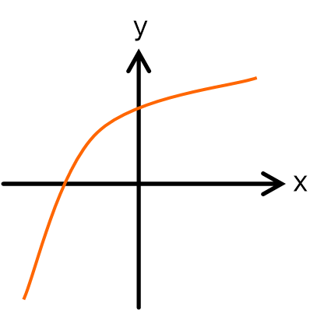
Presentation
Credit Clusters Analysis
1
2
3
Low R² Values
Limited Predictive Power
Implications for Modeling
- R² values close to zero
- Consistent across all credit clusters
- Indicates weak linear relationship
- Credit scores alone insufficient
- Poor premium predictions
- Unable to capture variations
- Fails to explain premium differences
- Suggests complex relationships
- Need for non-linear approaches
- Consider interaction effects
- Explore feature engineering
- Investigate other variables

Slide 19
Presentation
Regression Analysis Limitations
High Premium Prediction Issues
Possible Underlying Reasons
Lack of Prediction Diversity
Scatter Plot Distribution
- Predictions clustered around mean
- Limited range of outcomes
- Fails to capture variability
- Oversimplifies premium structure
- Underestimation of high premiums
- Poor performance for outliers
- Fails to capture risk factors
- Limits model's practical use
- Horizontal trend in plots
- Lack of clear linear relationship
- Suggests weak correlations
- Indicates complex interactions
- Cluster features not fully utilized
- Linear model limitations
- Complex premium determinants
- Need for advanced techniques

Slide 20
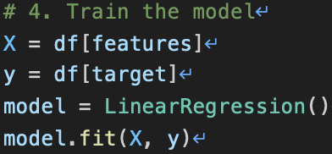
Presentation
Linear Regression Implementation
Input Variable Normalization
Goal of the Model
Model Training Process
- Predict insurance premiums
- Use customer information
- Provide personalized estimates
- Support pricing decisions
- Applied MinMaxScaler
- Scaled all variables to 0-1
- Eliminated scale differences
- Enhanced model comparability
- Used 8 selected variables
- Applied linear regression
- Learned variable relationships
- Optimized for premium prediction
Selected Variables for Prediction
Potential Model Improvements
- Age and gender
- Education level
- Smoking status
- Exercise frequency
- Health and credit scores
- Insurance period
- Income (if available)
- Explore non-linear models
- Incorporate interaction terms
- Feature engineering
- Ensemble methods
- Collect more relevant data

Slide 21
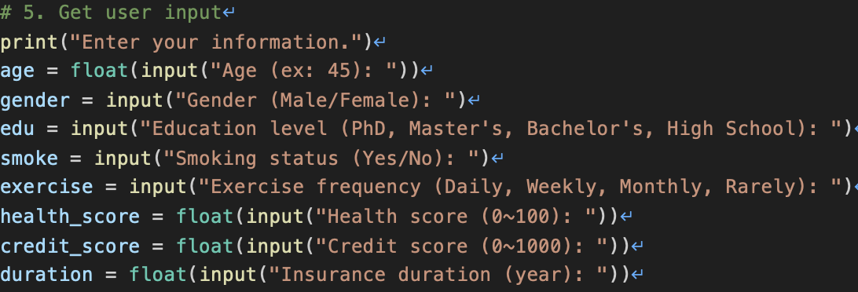
Presentation
User Input Process
3
2
Data Collection
Data Conversion
Data Processing
- Collect user input for 8 variables
- Age, gender, education level
- Smoking status, exercise frequency
- Health score, credit score
- Insurance period
- Convert categorical to numerical
- Gender: Male=0, Female=1
- Smoking: Non-smoking=0, Smoking=1
- Education: Ordinal encoding
- Exercise: Frequency to numerical
- Process input data consistently
- Apply same preprocessing steps
- Ensure compatibility with model
- Maintain data integrity
- Standardize input format

Slide 22



Presentation
End-to-End Analysis Process
1
2
3
4
Data Prep
Clustering
Regression
Prediction
- Preprocess data
- Handle missing values
- Encode categories
- Normalize features
- Create group scores
- Apply K-Means
- Group customers
- Personal scores
- Health scores
- Other scores
- Train models
- Cluster-specific
- Linear regression
- Evaluate: MAE, RMSE
- Assess R² scores
- Implement function
- Take user input
- Process new data
- Apply model
- Output premium

Slide 23




Presentation
Project Conclusion
Clustering
Regression
Limitations
Visualization
Overall Impact
- Grouped customers
- Based on scores
- Personal, health
- Credit aspects
- Identified patterns
- Cluster models
- Linear approach
- Predict premiums
- Limited power
- R² near zero
- Low diversity
- Average-centric
- High premium gap
- Simple model
- Complex patterns
- Scatter plots
- Horizontal trend
- Cluster overlap
- Limited separation
- Need improvement
- End-to-end process
- Data to prediction
- Insights gained
- Areas for growth
- Future potential

Slide 24

Presentation
Enhancing Model Performance and Predictive Power
Future Improvements
To boost our model's performance, we plan to implement nonlinear models that can capture complex relationships in our data. We'll also introduce interactive variables to account for interdependencies between customer characteristics.
Our project has laid a foundation for premium prediction, but there's room for significant enhancements. We've identified key areas that could dramatically improve our model's accuracy and applicability.
Strategies for Comprehensive Data Analysis
We aim to strengthen our feature engineering process, extracting more meaningful insights from existing data. Additionally, we'll focus on collecting additional variables to provide a more comprehensive view of customer profiles and risk factors.

Slide 25

Presentation
Team Roles and Contributions
Our team collaborated effectively, leveraging each member's strengths to deliver a comprehensive analysis. The division of responsibilities ensured a smooth workflow and allowed for in-depth focus on crucial aspects of the project.
Data Preprocessing and Modeling
Clustering-based regression
Presentation and Documentation
Park Yuran (202239872):
Preprocessing, clustering, end-to-end
Kim Dooyong (202135307):
Clustering-based regression analysis
Lee Hyunsoo (202336120):
Production and presentation of ppt

Slide 26



Presentation
Thank You
- We explored customer segmentation using K-Means clustering
- Developed cluster-specific linear regression models
- Implemented an end-to-end premium prediction process
- Identified limitations in linear regression's predictive power
- Future improvements:
• Apply nonlinear models
• Add interactive variables
• Strengthen feature engineering
• Collect additional relevant data
- Thank you for your attention!

